Slide 1
Cold Call Lift PoC Introduction – For Markets
GDIM CD

Slide 2


Background
Overview
Cold Call is one of the very important approach used within Markets team for business development program.
Every broker is requested to make a certain amount of outbound cold call every week, they may find the cold call target by:
Search from recruitment website(e.g. 51job) – as new as possible
Search from yellow page website(e.g. 11467.com) – as giant as possible
Go to office building to chat on-site – as detail as possible
Problems
Low working efficiency
Lack of systematic management
Hard to do advanced campaign management
Opportunities
Scrape company information (contact) from website automatically
Manage cold call relevant data properly
Continuous optimization of cold call process
Advanced analysis, full-lifecycle campaign management

Slide 3






General Process
City
Issue Date
Industry
Official Website
Xin
Contact
Storage
Delta Process
Analysis
Company Name & Address
Recruitment Info
Official Contact
Registration Info
Building Info(Localization)
Surround search
Delivery (Modeling)
Feedback

Slide 4
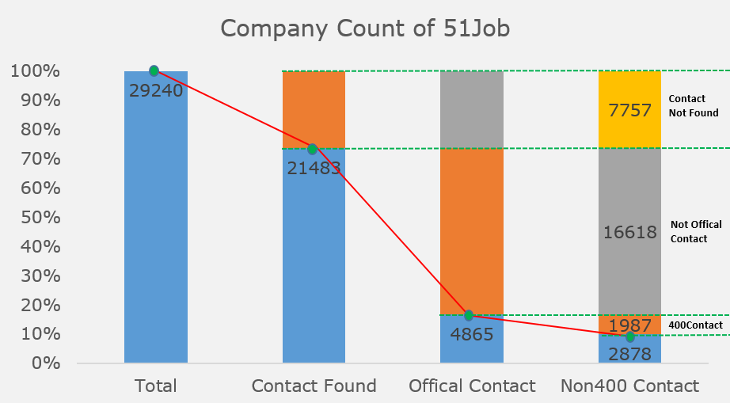
Project Current Status
Business Scenarios
Data crawling from recruitment website such as 51job, liepin etc.
Yellow Page
POI data near a given building(for most of the case buildings contracted with JLL)
Next Action Items:
Provide list to Markets team
Collect transaction data properly
Collect feedback and analyze data
Continuous optimization
Output of Phase 1:
Companies list with:
~3000 records
Valid contact number (from official website, non-400)
Any other filters? (according to existing attributes and business requirement)
326434 26096 7430 3389

Slide 5
Project Plan
Data
Data Collection – Internet, Manual, Feedback
Data Management – Filter, Analysis, Event-Trigger
System
Company MDM – Basic information
CRM – Dynamic and credible data
Process
Call Centre - Specialized team
Precision Marketing
OLM – Online Marketing
Campaign Management
Advanced Analysis – Classification, Regression

